Slide 1
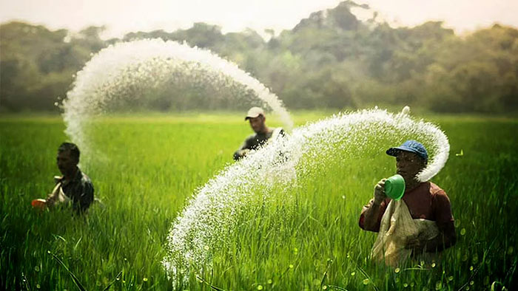


First Update Market and Business Environment Report—Agrochemicals and Plant Micronutrients
Prepared By:
Prepared For:
www.chemanalyst.com
December 02, 2022

Slide 2

Agrochemicals

Slide 3
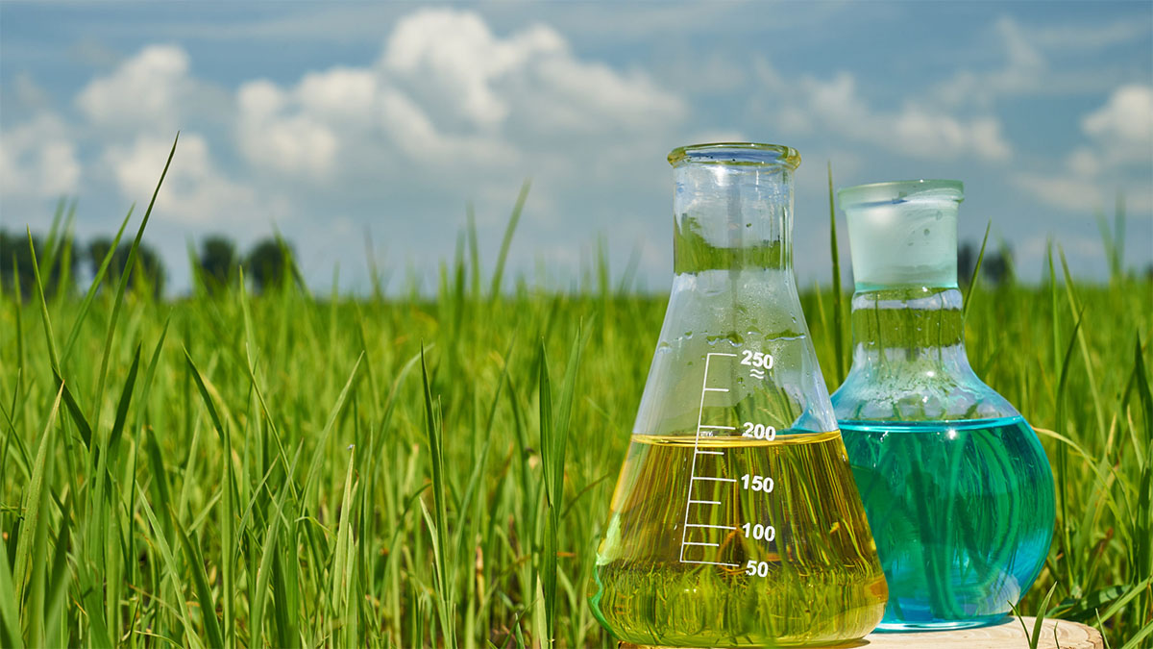
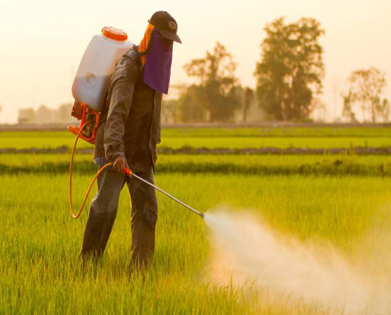
Product Overview- Agrochemicals
Agrochemicals are pesticides, herbicides, or fertilizers used for the management of ecosystems in agricultural sectors. Rudimentary variations on agrochemicals have been used for millennia to improve crop yields and control the populations of agricultural pests.
The earliest known use of agrochemicals dates to roughly 2500 B.C. when Sumerian farmers relied on Sulphur (S) compounds to reduce insect populations and the subsequent risk of pest-related famine.
Types of Agrochemicals-
There is a concerted effort to actively and conscientiously implement a broad range of agrochemicals to safely maintain and control the global food supply to ensure consistently high quality for widespread consumption. Types of agrochemicals include:
Pesticides, or chemicals engineered to destroy insects and other organisms, weeds, and funguses that could spoil crop yields;
Synthetic fertilizers, for example ammonium nitrate (NH4NO3), which is designed to encourage crop growth by saturating soils with nutrients;
Acidifiers and liming agents, engineered to alter the pH levels of soils to suit the planting properties of given crops;
Soil conditioners, for example gypsum (CaSO4·2H2O), which is designed to condition soils with high sodium (Na) contents to improve planting conditions;
Growth hormones, or synthetic chemicals designed to increase growth rates in animals and crops.

Slide 4
Global Agrochemicals Market, By Value & Volume
Figure 1: Global Agrochemicals Market Size, By Value (USD Billion) & By Volume (in MMT), 2017, 2021, 2025F, 2030F, 2035F, 2040F
CAGR 2017-2021
By Value: 2.9%
CAGR 2021-2030F
By Value: 4.5%
CAGR 2030-2040F
By Value: 3.4%
CAGR 2017-2021
By Volume: 2.3%
CAGR 2021-2030F
By Volume: 3.9%
CAGR 2030-2040F
By Volume: 3.0%
Global Agrochemicals market stood at USD 220 billion and is expected to reach USD 324 billion at a CAGR of 4.5% by 2030 and 454 billion by the end of 2040 at a CAGR of 3.4%.
Covid did not affected the agrochemicals market owing to increase in demand of consumables in that period.
Initiatives such as “Make in India” and the PLI Scheme improve the manufacturing sector dynamics of India, and hence more industries are established.
Source: ChemAnalyst

Slide 5
Global Agrochemicals Market, By Value
Figure 2: Global Agrochemicals Market, By Type, By Value (USD Billion), 2017, 2021, 2025F, 2030F, 2035F, 2040F
Total in USD Billion
197
220
256
324
390
454
Others: Biopesticides, etc.
Insecticides is India's most demanded Agrochemicals, having a market share of more than 50%, and it stood at USD 117.8 billion in FY2021.
In the forecast period, it is expected that insecticides will dominate the agrochemicals with a market share of over 50%.
Source: ChemAnalyst

Slide 6
Global Agrochemicals Market, By Volume
Figure 2: Global Agrochemicals Market, By Type, By Volume (MMT), 2017, 2021, 2025F, 2030F, 2035F, 2040F
Total in MMT
171
187
213
263
309
355
Others: Biopesticides, etc.
Source: ChemAnalyst

Slide 7
India Agrochemicals Market, By Value & Volume
Figure 3: India Agrochemicals Market Size, By Value (USD Billion) & By Volume (in MMT), 2017, 2021, 2025F, 2030F, 2035F, 2040F
CAGR 2017-2021
By Value: 8.3%
CAGR 2021-2030F
By Value: 10.4%
CAGR 2030-2040F
By Value: 8.4%
CAGR 2017-2021
By Volume: 8.0%
CAGR 2021-2030F
By Volume: 9.8%
CAGR 2030-2040F
By Volume: 8.1%
India Agrochemicals market stood at USD 6.3 billion and is expected to reach USD 15.2 billion at a CAGR of 10.4% by 2030 and 34.7 billion by the end of 2040 at a CAGR of 8.4%.
India is the fourth-largest producer of agrochemicals in the world after USA, Japan and China.
The major dynamics to the agrochemicals market includes, decreasing arable land, declining soil fertility, heavy dependency on monsoon for irrigation and many more.
Source: ChemAnalyst

Slide 8
India Agrochemicals Market, By Value
Figure 4: India Agrochemicals Market, By Type, By Value (USD Billion), 2017, 2021, 2025F, 2030F, 2035F, 2040F
Total in USD Billion
5
6
9
15
24
35
Others: Biopesticides, etc.
Source: ChemAnalyst

Slide 9
India Agrochemicals Market, By Volume
Figure 4: India Agrochemicals Market, By Type, By Volume (MMT), 2017, 2021, 2025F, 2030F, 2035F, 2040F
Total in MMT
3
4
6
10
15
21
Others: Biopesticides, etc.
Source: ChemAnalyst

Slide 10
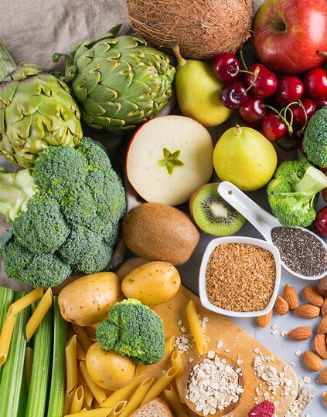
Plant Micronutrients

Slide 11
Product Overview- Plant Micronutrients
Micronutrients are essential plant nutrients that are found in trace amounts in tissue but play an imperative role in plant growth and development. Without these nutrients, plant nutrition would be compromised leading to potential declines in plant productivity. Of the 17 elements essential for plant growth, eight are micronutrients: boron (B), chlorine (CI), copper (Cu), iron (Fe), manganese (Mn), molybdenum (Mo), zinc (Zn) and nickel (Ni).
Mineral elements nurture horticultural crops and also crops of cereals, pulses, oilseeds, spices, and plantation. In spite of the low demand, critical plant functions are hindered if micronutrients are unavailable, which results in plant deformations, lower yield, and diminished growth. Micronutrients are crucial for plant growth and play an important role in balancing crop nutrition.
There is increasing interest from the agricultural community in micronutrient fertilization for a variety of reasons including:
soil erosion and long-term cropping have resulted in the removal of micronutrients from soils;
increasing crop yields generally leads to greater micronutrient removal rates in grain and other harvested products; and
the widespread replacement of micronutrient-rich manures with mineral fertilizers has reduced micronutrient addition from fertilizer sources. Collectively, these factors have led farmers to question whether micronutrient fertilization may now be required to meet the changing demands of crop nutrition.

Slide 12
Global Plant Micronutrients Market, By Value & Volume
Figure 1: Global Plant Micronutrients Market Size, By Value (USD Billion) & By Volume (in KT), 2017, 2019, 2021, 2025F, 2027F
CAGR 2017-2021
By Value: 6.8%
CAGR 2022-2027F
By Value: 8.3%
CAGR 2017-2021
By Volume: 6.1%
CAGR 2022-2027F
By Volume: 7.6%
Global Plant Micronutrients market stood at USD 3.6 billion and is expected to reach USD 6.5 billion at a CAGR of 8.3% by 2027
This is attributable to the deteriorating soil quality in cultivated lands. Micronutrients for crops are essential for plant growth and metabolic processes.
The market for crop micronutrients is expanding as a result of factors like rising public awareness of the advantages of crop micronutrients for crop productivity and yields.
Source: ChemAnalyst

Slide 13
India Plant Micronutrients Market, By Value & Volume
Figure 1: India Plant Micronutrients Market Size, By Value (USD Billion) & By Volume (in KT), 2017, 2019, 2021, 2025F, 2027F
CAGR 2017-2021
By Value: 8.8%
CAGR 2022-2027F
By Value: 9.2%
CAGR 2017-2021
By Volume: 8.3%
CAGR 2022-2027F
By Volume: 8.8%
India Plant Micronutrients market stood at USD 0.6 billion and is expected to reach USD 1.1 billion at a CAGR of 9.2% by 2027.
Micronutrients are essential for a balanced diet and a great tool for farmers to improve crop quality and yield.
The market value for agricultural micronutrients has increased as a result of the expanding trend of biofortification in mungbean, wheat, maize, potatoes, and sweet potatoes.
Source: ChemAnalyst

Slide 14

Diesel Exhaust Fluid (AdBlue)

Slide 15


Product Overview- Diesel Exhaust Fluid (AdBlue)
AdBlue is a diesel exhaust fluid used in vehicles with Selective Catalytic Reduction (SCR) technology to reduce harmful gases being released into the atmosphere. AdBlue is a 32,5 % solution of high-purity, synthetically manufactured urea in de-mineralized water. It is a safe-to-use fluid.
AdBlue is used in vehicles with a Selective Catalytic Reduction catalyst, or SCR. An SCR catalyst ensures that exhaust gases are treated before they leave the vehicle. A large proportion of the heavy-duty vehicles complying with the Euro 4, Euro 5 and Euro 6 standards are equipped with an SCR system and therefore use AdBlue. This applies to most trucks after 2005; the first passenger cars with diesel engines and SCR were introduced in response to the Euro 6 standard in 2014.
AdBlue aims to significantly reduce emissions of nitrogen oxide (NOx) which are harmful to the environment and thus meet the stringent emission limits set by European standards (Euro 6) - which are standard for the control of emissions of new vehicles sold in the European Union and America.
AdBlue fluid treatment is injected into the exhaust gases and can filter out more than 90% of the harmful gas emissions of nitrogen oxide into steam and nitrogen, resulting in less pollution.

Slide 16
Global Diesel Exhaust Fluid (AdBlue) Market, By Value & Volume
Figure 1: Global Diesel Exhaust Fluid (AdBlue) Market Size, By Value (USD Billion) & By Volume (in Billion Litres), 2017, 2021, 2025F, 2030F, 2035F, 2040F
CAGR 2017-2021
By Value: 7.5%
CAGR 2021-2030F
By Value: 9.3%
CAGR 2030-2040F
By Value: 8.1%
CAGR 2017-2021
By Volume: 4.7%
CAGR 2021-2030F
By Volume: 7.9%
CAGR 2030-2040F
By Volume: 7.2%
Global Diesel Exhaust Fluid (AdBlue) market stood at USD 18 billion in 2021 and is expected to reach USD 41 billion at a CAGR of 9.3% by 2030 and 89 billion by the end of 2040 at a CAGR of 8.1%.
Due to rising auto manufacturing in nations like China and India, the Asia-Pacific region dominates the market for Diesel Exhaust Fluid (AdBlue).
The diesel exhaust fluid market is expanding as a result of the rising number of DEF pumps, rising average vehicle age, and rising mileage.
Source: ChemAnalyst

Slide 17
Global Diesel Exhaust Fluid (AdBlue) Market, By Value
Figure 2: Global Diesel Exhaust Fluid (AdBlue) Market, By Application, By Value (USD Billion), 2017, 2021, 2025F, 2030F, 2035F, 2040F
Total in USD Billion
14
18
29
41
61
89
Others: Mining, Generators etc..
Automotive segment holds largest share of overall demand, having a market share of more than 50%, and it stood at USD 9 billion in FY2021.
In the forecast period, it is expected that automotive segment will dominate the Diesel Exhaust Fluid (AdBlue) with a market share of over 50%.
The low cost of production and growing use of Adblue in farm equipment have further fueled the Indian Adblue Market, which is focused on agriculture.
Source: ChemAnalyst

Slide 18
Global Diesel Exhaust Fluid (AdBlue) Market, By Volume
Figure 2: Global Diesel Exhaust Fluid (AdBlue) Market, By Application, By Volume (Billion Litres), 2017, 2021, 2025F, 2030F, 2035F, 2040F
Total in Billion Litres
26
31
45
61
86
122
Others: Mining, Generators etc..
Source: ChemAnalyst

Slide 19
India Diesel Exhaust Fluid (AdBlue) Market, By Value & Volume
Figure 3: India Diesel Exhaust Fluid (AdBlue) Market Size, By Value (USD Billion) & By Volume (in Billion Litres), 2017, 2021, 2025F, 2030F, 2035F, 2040F
CAGR 2017-2021
By Value: 4.7%
CAGR 2021-2030F
By Value: 13.6%
CAGR 2030-2040F
By Value: 11.4%
CAGR 2017-2021
By Volume: 8.3%
CAGR 2021-2030F
By Volume: 11.05%
CAGR 2030-2040F
By Volume: 10.5%
India Agrochemicals market stood at USD 3.0 billion in 2021 and is expected to reach USD 9.4 billion at a CAGR of 13.6% by 2030 and 27.5 billion by the end of 2040 at a CAGR of 11.4%.
The severe emission standards that are causing a greater penetration of diesel SCR cars and an increase in the number of DEF pumps are the main factors anticipated to fuel the growth of the diesel exhaust fluid market during the forecast period.
Increased demand for heavy-duty trucks, improved infrastructure, and ongoing industrialization have all significantly boosted the AdBlue market in India.
Source: ChemAnalyst

Slide 20
India Diesel Exhaust Fluid (AdBlue) Market, By Value
Figure 4: India Diesel Exhaust Fluid (AdBlue) Market, By Application, By Value (USD Billion), 2017, 2021, 2025F, 2030F, 2035F, 2040F
Total in USD Billion
2
3
5
9
17
28
Others: Mining, Generators etc..
Source: ChemAnalyst

Slide 21
India Diesel Exhaust Fluid (AdBlue) Market, By Volume
Figure 4: India Diesel Exhaust Fluid (AdBlue) Market, By Application, By Volume (Billion Litres), 2017, 2021, 2025F, 2030F, 2035F, 2040F
Total in Billion Litres
2
3
5
8
14
22
Others: Mining, Generators etc..
Source: ChemAnalyst

Slide 22







Disclaimer :
The contents of this report are based on information generally available to the public from sources and primary interviews which are believed to be reliable. No representation is made that it is timely, accurate or complete. TechSci Research has taken due care and caution in compilation of data as this has been obtained from various sources including primary interviews which it considers reliable and firsthand. However, TechSci Research does not guarantee the accuracy, adequacy or completeness of any information and it is not responsible for any errors or omissions or for the results obtained from the use of such information and especially states that it has no financial liability whatsoever to the subscribers / users of this report. The information herein, together with all estimates and forecasts, can change without notice. All the figures provided in this document are indicative of relative market size and are strictly for client’s internal consumption. Usage of the same for purpose other than internal will require prior approval of TechSci Research.
CONTACT US
TechSci Research – North America
2950, Boundary Road, Burnaby, British Columbia, Canada
Tel: +1- 646- 360-1656
E: sales@techsciresearch.com
TechSci Research – Europe
54, Oldbrook, Bretton,
Peterborough,
United Kingdom
E: sales@techsciresearch.com
TechSci Research – Asia-Pacific
B-44, Sector -57, Noida, National Capital Region, UP, India
Tel: +91-120-4523900
E: sales@techsciresearch.com
TechSci Research
Cyber City, Building No. 8C, Gurgaon, National Capital Region, Haryana, India
Tel: +91-124-6428661
E: sales@techsciresearch.com
www.techsciresearch.com
INDUSTRY ASSOCIATIONS
The information contained herein is of a general nature and is not intended to address any particular situation, individual or entity. No one should act upon such information without appropriate professional advice.
2021 © TechSci Research All Rights Reserved.

